Slide 1
Module 2: Gender balance through language

Slide 2
Table of contents
2.1 List of terms
2.2 Gender balance through language
2.3 Examples of inclusive language
2.4 Perception of gender in education
Gender balance through language: Trainees will be supported on identifying sexist language and will be trained in gender – neutral language use. Information and examples on the use on non-restrictive gender pronouns, as well as other non-binary vocabulary will be included

Slide 3
Why should you do this module
We use language to communicate with each other, so the vocabulary, structures, and topics we use have a great impact on what message we end up sending to the other person
Language use has a crucial role in creating an educational environment that is gender-inclusive or that is exclusionary

Slide 4
Questions to start the module with
Do you know what the difference is between “sex” and “gender”?
How many genders are there?
How does language contribute to a gender-inclusive classroom?
Why should you use singular “they” in education?

Slide 5
Module’s objective
To explain the terminology connected to language use and gender-inclusivity
To give examples about what to consider in your educational practice
To give you some literature to consult before putting together your class

Slide 6
2.1 List of basic terms
Many people think of the terms “sex” and “gender” as interchangeable. While these two terms are connected, the picture is not as simple.
Sex
Sex is generally assigned based on a baby’s genitalia
Gender
Gender refers to the social attributes and opportunities associated with being male and female and the relationships between women and men and girls and boys, as well as the relations between women and those between men. These attributes, opportunities and relationships are socially constructed and are learned through socialization processes. They are context/ time-specific and changeable.
Gender determines what is expected, allowed and valued in a woman or a man in a given context. In most societies there are differences and inequalities between women and men in responsibilities assigned, activities undertaken, access to and control over resources, as well as decision-making opportunities. Gender is part of the broader socio-cultural context.

Slide 7
Overview of basic terms
SEX is what you were assigned at birth, based on a combination of physical features
GENDER IDENTITY is your innermost concept of self as female, male, a blend of the two, or something else
GENDER EXPRESSION is the external appearance of your identity and what others perceive of you

Slide 8
Some other relevant terms
GENDER ROLE is the set of functions, activities, and behaviours commonly expected of girls/women and boys/men by society.
GENDER STEREOTYPES is a generalized view or preconception about attributes or characteristics, or the roles that are or ought to be possessed by, or performed by, women and men. A gender stereotype is harmful when it limits women’s and men’s capacity to develop their personal abilities, pursue their professional careers and/or make choices about their lives
GENDER LITERACY is the ability to participate knowledgeably in discussions of gender and gender-related topics.

Slide 9
2.2 Gender balance through language
The vocabulary of gender continues to evolve and there is no universal agreement about the definitions of many terms.
Nonetheless it is always worth doing our best to stay informed. The precise use of terms in regards to gender can have a significant impact on overcoming many of the misperceptions and biases associated with gender.

Slide 10
Legal aspects
“in all written documents and where appropriate and feasible in oral expression, either explicitly use the female and male forms or gender-neutral terms.”

Slide 11
Inclusive learning environment
Inclusive pedagogical environment is a philosophy of teaching that ensure equal opportunities for all students to have a successful learning experience. An inclusive pedagogy must engage both majority and minority students through participation, collaboration and good relationship in both student-student relations and student-teacher relations .
The academic dimension of inclusion depends on adaptations of the curriculum, adapted assessments, adapted teaching, high-quality education, learning outcomes, and higher achievement levels.
REF:
Succeeding in inclusive practices in school in Norway – A qualitative study from a teacher perspective Open Access
Hanne Marie Høybråten Sigstad, Jorun Buli-Holmberg & Ivar Morken
European Journal of Special Needs Education, Volume 37, 2022 Issue 6 Pages 1009-1022, Published online: 03 Nov 2021
Some References
Editorial: Keeping education fresh
Beatrix Fahnert FEMS Microbiology Letters, Volume 364, Issue 18, September 2017, fnx175, https://doi.org/10.1093/femsle/fnx175
Rubrics: tools for making learning goals and American Association for the Advancement of Science. . Vision and Change in Undergraduate Biology Education: A Call to Action, Washington, DC 2011
Preparing the next generation of faculty: graduate school as socialization to the academic career. J High Educ 2002 ;73- 94
Teaching to student diversity in higher education: How multiple intelligence theory can help. Teach High Educ 2004 ;9 :421–34
A professional development teaching course for science graduate students. J Coll Sci Teach 2007 ;36 :16

Slide 12
2.3 Examples of inclusive language
What language you use matters even in STEM classes. Even if you feel you are working with hard science, your choices related to the way you communicate it influence your students.
In the following you will see some specific examples to consider when preparing for and giving your lectures and seminars.

Slide 13
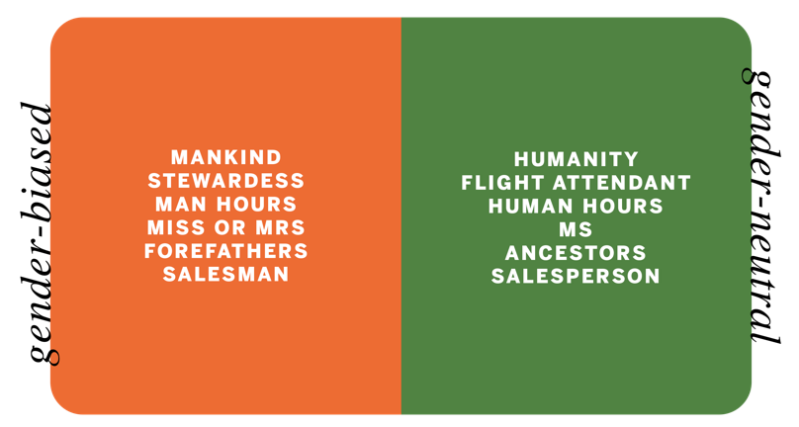
Vocabulary that assigns gender

Slide 14
Pronouns: singular “they”
The most gender-inclusive way to talk about a person in English is to use singular “they”. The singular they is used in 3 main contexts:
To refer to people who specify their pronoun to be "they"
To refer to people whose gender is unknown to us/the speaker,
To refer to people whose gender is irrelevant for the specific context. ("I fell on the street but somebody helped me up. It was so nice of them".)

Slide 15
2.4 Perception of gender in education
According to our survey, students are impacted by teachers’ choice of language use.
For example, what pronouns they use, what examples they provide, what topics they choice to relate the matter to real life, as well as what textbooks they assign.

Slide 16
Does your class use gender-neutral language?
Do you refer to an engineer as he/him or with a male name?
Do you refer to a STEM student as he/him or with a male name?
Do you assume that your female students are less likely to know the answer?
Do you use examples that come from books authored by men?
Do you use scenarios that cover one or few interests (for example, competitive games, war, car racing, etc.)?

