Slide 1
Module 4 DEVELOPMENT OF GENDER EQUITABLE AND INCLUSIVE TEACHING MATERIAL

Slide 2
Introduction
Teaching and learning materials are powerful role models because the images and language with which teachers and students interact can impact their understanding of a subject. By developing teaching material and examples free of bias that promote equality, inclusiveness and intersectionality can help to break down gender stereotypes

Slide 3
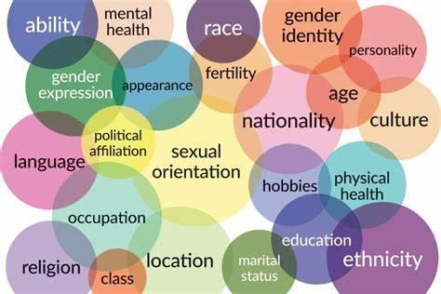
Introduction: stereotypes and biases
Stereotypes and biases are important cultural factors that may influence women’s representation in the STEM areas. A stereotype is an association of specific characteristics with a group (Dovidio et al., 2010). Stereotypes can be descriptive (what women and men are like) or prescriptive (what women and men should be like). Stereotypes are very powerful and difficult to override, and they can lead to biased behavior or discrimination when we view members of a group based on their group status rather than as individuals (Heilman, 2012; Dovidio et al., 2010).

Slide 4
Outcome of the module
This module gives some examples to help trainees to develop inclusive examples free of gender stereotypes and/or gender bias.

Slide 5
4.1 The influence of gender bias in teaching examples (1/3)
Educators at all levels influence how students perceive the STEM fields, as well as how students view themselves. Environmental factors, classroom gender composition and faculty gender are also significant issues that impact STEM students’ engagement and success (Bailey et al., 2020; Olsson & Martiny, 2018; Solanki & Xu, 2018).
Despite remarkable progress made over the last decades to mitigate gender bias in academia, gender bias can still form a bottleneck for gender equity in STEM and can sometimes lead to a gradual abandonment of scientific careers by many women.

Slide 6
4.1 The influence of gender bias in teaching examples (2/3)
Reducing bias against women in the STEM areas is a society-wide endeavor.
Some of the main themes to promote inclusiveness and to reduce gender bias in teaching and learning material are listed below:
Change cultural stereotypes that lead to gender biases—for example, that men are better than women at math, science, and other skills that engineers and computing professionals need. Often, men and women are portrayed in stereotypical ways.
Women are often portrayed in soft technological areas, while men are often portrayed in more technical advanced and innovative areas. A best practice for teaching and learning materials is to depict all social groups as equals who interact in respectful ways, through traditional and nontraditional roles.
Making the examples socially relevant can contribute to increasing students’ interest and engagement and to stimulate them to see themselves as a part of the STEM areas and educational programs.

Slide 7
4.1 The influence of gender bias in teaching examples (3/3)
Embed diversity in your examples, and show, if possible, environments, technical solutions and/or products that capture diversity, multicultural issues and environments in which minority groups are likely to be engaged in their work and commitment to contribute to societal and technical development and innovation.
Change the frequency of representations. Dominant subgroups are often portrayed in teaching and learning materials more frequently and more positively than are other groups. However, characters in materials should reflect a society’s diversity and distribution and should represent the range of characteristics in a society in positive and inclusive ways.
Students identify with characters who are similar to themselves (e.g., are the same sex, have the same physical characteristics); therefore, ensuring equal representation of all individuals in teaching and learning materials can help expose children to positive messages and provide powerful role models.

Slide 8
4.2 Students’ perceptions of gender (1/2)
The picture shows some expressions from students in the STEM areas (Vimarlund V, 2019).
Students’ perception of gender
Data was collected in a survey conducted within the WOMEN-STEP project 2023.

Slide 9
4.2 Students’ perceptions of gender(2/2)
Teachers frequently form attitudes based on stereotyping acquired from their own upbringing and culture. For instance, although the engineering profession does not exclude women, in some cultures this profession tends to favor males, thus reinforcing existing stereotypes.
So, what can teachers do when they find gender inequities in teaching materials in areas in which gender is not a given component or focus?
The answer is: it depends. Some teachers can make changes to their materials or the way in which they use them. Other teachers may be able to create original teaching content or to develop new examples in which they can describe themes, contexts or material that can be connected to intersectionality issues. Although many subjects do not have gender as a given parameter or factor, it is possible to take gender and intersectionality into account in the examples we use in our teaching.

Slide 10
Gender bias: some examples
Below we present some examples showing the absence of gender issues and how to make examples free from gender bias.

Slide 11
Example 1: Haptic Technology
Potential consumers of technology have different characteristics (gender identities, sex, age, ethnicity, profession, occupation, education, income, household and living arrangements, familiarity with and attitudes towards technology, etc..
Engineers are designing new ways to communicate touch virtually through haptic devices. This raises questions about how touch should be employed in robotics. Can touch between a human and a robot or mediating haptic device have the same meaning as it does between two humans?
Normally issues related to if gender or intersectionality influence the effectiveness of the tactile sensation are not considered. The pictures usually use men as the norm.
Haptic technology is the science of applying tactile sensation.

Slide 12
Example 2 Haptic Technology
Examples can suggest different contexts, different patterns of use by different groups of potential consumers or different areas in which technology is applied. Self-driving cars use to include pictures that give the impression that they are an easy and effective solution for females.

Slide 13
Questions to consider when selecting examples
What are the potential application areas of the technology (e.g., professional life, leisure activities, home, etc.).
Is it possible to develop socially relevant examples?
How different groups of potential consumers (e.g., non-binary individuals, women, or men, old or young, etc.) are represented?
Do different groups have different expectations regarding the interface?
Do certain features reinforce existing gender inequalities, gender norms or stereotypes?
Do different groups of potential consumers have different expectations regarding the features and functions or exterior design?

Slide 14
Examples 2: Gender and intersectionality in social robots:
Humans—whether as designers or users—tend to gender machines (because, in human cultures, gender is a primary social category).
The issue is.
Does gendering robots enhance acceptance by humans?
Does it enhance performance when humans and robots collaborate? ,Or should the gendering of robots be resisted?
Does it reinforce gender stereotypes that amplify social inequalities?
The danger is that designing hardware toward current stereotypes can reinforce those stereotypes. The challenge for designers is to understand how gender becomes embodied in robots to design robots in ways that promote social equality.

Slide 15
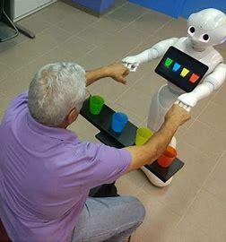
Social Robots and the absence of intersectionality (1/2)
Social robots are artificial intelligence platforms, paired with sensors, cameras, microphones and other technology, like computer vision, so they can better interact and engage with humans or other robots. Robots, in general, are designed in a world with gender norms, gender identities, and gender relations.
Humans’ project gender onto robots, including expectations about how "male" and "female" entities should act and tend to treat robots like humans, projecting human characteristics, such as personality onto machines.

Slide 16
Social Robots and the absence of intersectionality (2/2)
When illustrating the potential areas of application of novel technology, it is important to consider:
If there is a risk of stereotyping or offending potential consumers through the exterior design (e.g., imposing role models, avatars, different forms of sexism, or racism etc.)
Is there a risk of excluding certain groups (e.g., the elderly) through the technology design?
If dominant subgroups are portrayed in teaching and learning materials more frequently and more positively than are other groups.

Slide 17
Social Robots and the absence of intersectionality (3/2)
If the examples or teaching materials reflect a society’s diversity and distribution
If the examples represent the range of characteristics in a society in positive and inclusive ways. Students identify with characters who are like themselves (e.g., are the same sex, have the same physical characteristics); therefore, ensuring equal representation of all individuals in teaching and learning materials can help expose children to positive messages and provide powerful role models.
If certain configurations reinforce existing social roles (e.g., gender segregation in the workforce; men associated with engineering and women with domestic technologies, for example).

Slide 18
Sensors
Sensors are normally developed with males as norm. Solutions cannot be extended to many. Different races, individuals and even individuals with some disabilities are not represented or excluded.
Sensors do not always react to people from different races.
How the same solution benefits people in general or the benefits of introducing new technology although not satisfactory for everyone is not explained.

Slide 19
Example 4: Facial recognition systems (FRSs)
(FRSs) can identify people in crowds, analyze emotion, and detect gender, age, race, sexual orientation, facial characteristics, etc. These systems are often employed in recruitment, authorizing payments, security, surveillance, and unlocking phones.
Despite efforts by academic and industrial researchers to improve reliability and robustness, recent studies demonstrate that these systems can discriminate based on characteristics such as race and gender, and their intersections (Buolamwini & Gebru, 2018)

Slide 20
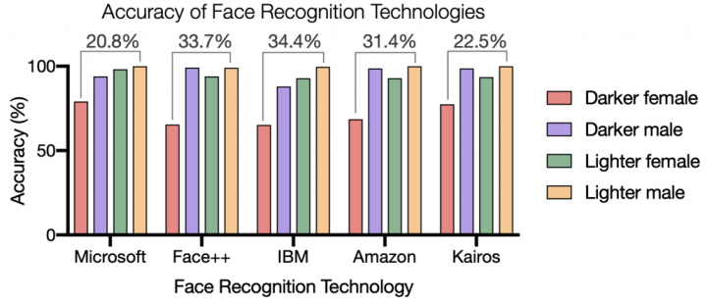
Facial recognition programs
Examples of facial recognition programs show that men are more easily recognized than women, and that non-white individuals are not easy to recognize.
The level of reliability in facial recognitions is shown below (source : The Gender Shades project revealed discrepancies in the classification accuracy of face recognition technologies for different skin tones and sexes.

Slide 21
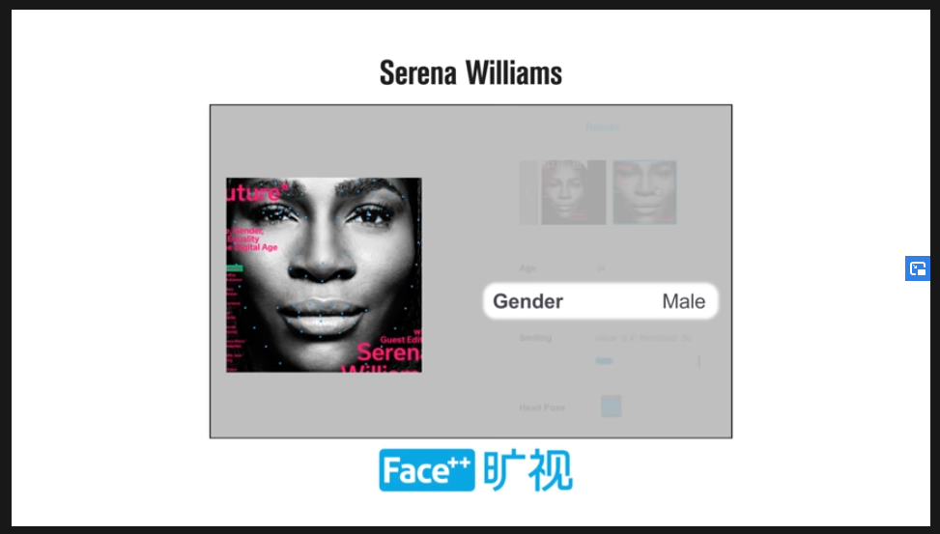
AI failures
AI failures on the faces of iconic women like Serena Williams, Oprah Winfrey, and Michelle Obama (Ref: The Algorithmic Justice League (AJL). A digital advocacy non-profit organization based Cambridge, Massachusetts)

Slide 22
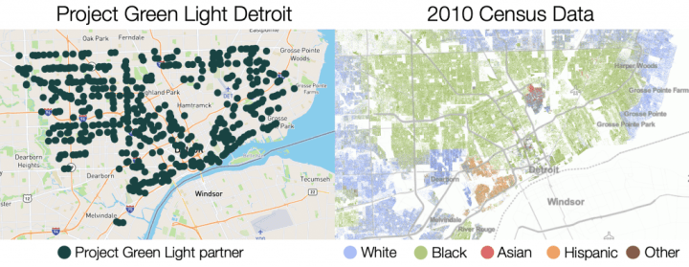
Face recognition in racial discrimination by law enforcement
Black Americans are more likely to be arrested and incarcerated for minor crimes than White Americans. Consequently, Black people are overrepresented in mugshot data, which face recognition uses to make predictions.
Racial bias in the application of face recognition technology. Locations of Project Green Light Detroit partners (left) overlap with primarily Black communities in data from the U.S. census (right). In this city-wide program, the brunt of the surveillance falls on Detroit’s Black residents.

Slide 23
Facial recognition and intersectionality

Slide 24
Issues to consider
Issues to consider when developing examples related gender and intersectionality in facial recognizing examples are:
Models trained on mature adults, for example, will not perform well on young people.
Use intersectional datasets such as gender and race.
Some parameters can influence the accuracy of the categories. For instance, wearing facial cosmetics can reduce the accuracy of facial recognition systems
Transgender people, may be identified incorrectly. (Source: Facial Recognition , Gendered Innovations “stanford.edu”.
Important to consider that Intersectionality includes several parameters to improve accuracy across diverse categories. Not only gender and sex.

Slide 25
Example 5: Making machines talk

Slide 26
Speech synthesis

Slide 27
4.3 How stereotypes can be reinforced
Many individuals still associate STEM fields with masculine qualities, leading to stereotypes that can discourage girls and women from pursuing STEM education and careers.
The issue is: Are differences between women, and men, and non-binary individuals that should be considered (e.g., in height, strength, range of motion, etc.) important for the examples I present in your courses?
Consider: Would certain configurations reinforce existing social roles (e.g., gender segregation in the workforce; men associated with engineering and women with domestic technologies, for example)?

Slide 28
Reinforcing stereotypes:some examples

Slide 29
Reinforcing stereotypes:some examples

Slide 30
Reinforcing stereotypes:some examples
Standards and reference models in Crash tests
The female part of the population is sometimes left out of the research discovery phase. Real and social oriented cases, for instance, public transportation and how to make it more user friendly and efficient for all users, do not consider gender diverse people and people from different socioeconomic and regional backgrounds. See an example below.
Crash test dummies are used in auto safety testing. These dummies vary by height and weight to represent human populations. The 50th percentile male dummy (a dummy modeling the average male body) is most used. A 5th percentile female crash test dummy (representing the smallest 5th percent of the female adult population) was introduced in 1966, but this dummy is simply a scaled version of the 50th percentile male body and does not model female bodies.
S

Slide 31
Standards and reference models in Crash tests
Still lacking is a 50th percentile female dummies that models female-typical injury tolerance, biomechanics, spinal alignment, neck strength, muscle and ligament strength, dynamic responses to trauma, and other female-typical characteristics.
Consequently, women sustain more severe injuries than men in comparable crashes. Male body is often defined as the norm and serves as the primary object of study. In this case, crash test dummies were first developed in the U.S. to model the 50th percent.

Slide 32
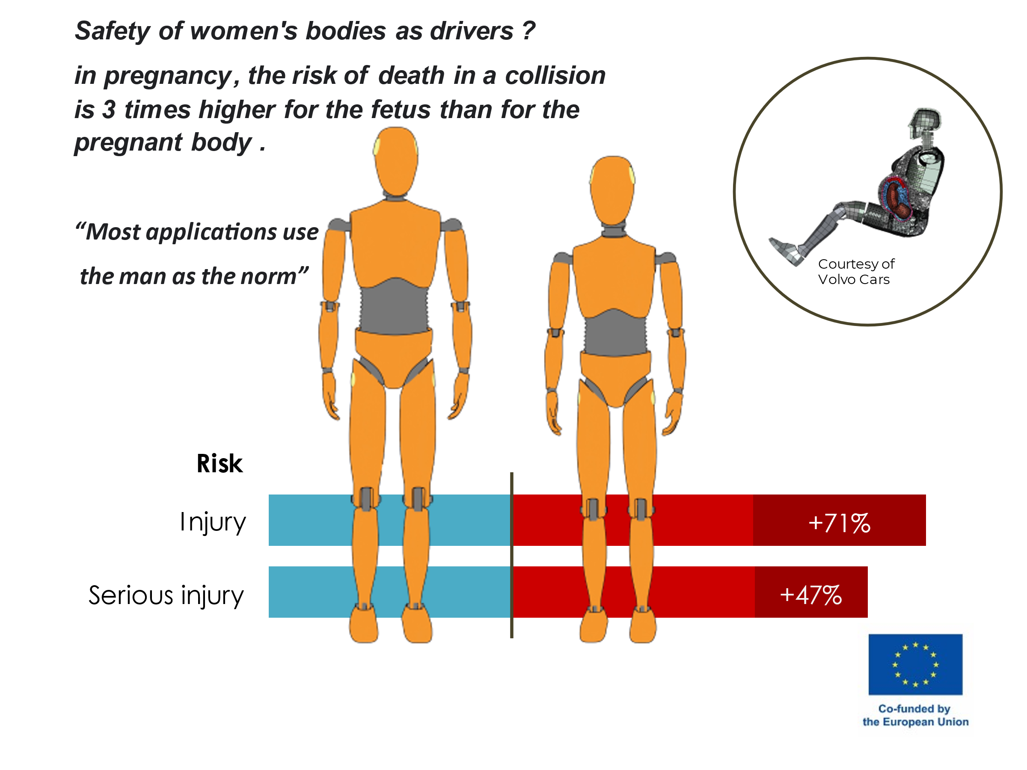
Standards and reference models in Crash tests

Slide 33
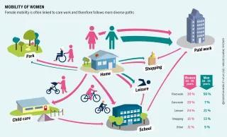
Mobility and transportation (1/2)
Mobility patterns tend to be gendered in terms of where, when, and why people take trips. Transportation planning—both for modes and infrastructures—often do not consider diverse users’ needs. For example, the need for safety can restrict mobility for specific women, gender nonconforming individuals, and the elderly.
Women typically walk longer distances than men and make frequent, shorter trips with more stops to combine multiple tasks. Men, by contrast, tend to follow more direct and linear patterns. Females engage in more non-work-related travel than males and are more likely to be accompanied by children or elderly relatives.

Slide 34
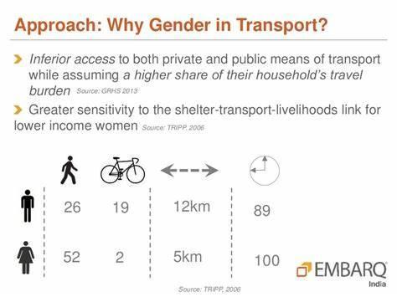
Mobility and transportation (2/2)
Understanding gender-specific needs across populations and capturing relevant functionalities, i.e. vehicle features and routes; and technologies used to access services (card vs bike), can help decision makers to capture differences in transport patterns or preferences for male and females and consider these issues when making socially relevant decisions.
Mobility is not gender neutral. This not only pertains to individual mobility, but also to the transport and planning sectors themselves, which are heavily dominated by men (only 22 percent of all employees in the transport sector are female). Social stereotypes and role distribution within a predominantly male workforce, as well as care work mostly carried out by females, do the rest to create an environment that is aligned with male needs. (Diehl , Cerny 2021).

Slide 35
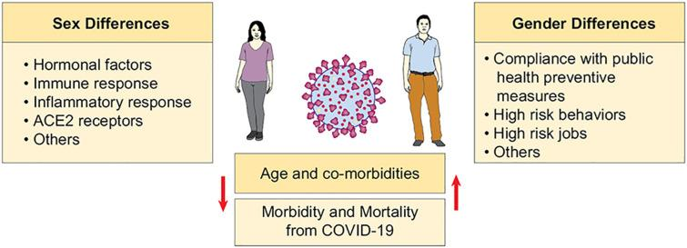
STAM cells research
STAM cells research, examples of the importance of gender were developed to explain the importance of biological sex and diversity and to illustrate gender differences in COVID 19-risk.
The COVID-19 pandemic has affected millions of patients across the globe. Multiple studies, national and international governmental data have shown important sex and gender differences in the incidence and outcomes of patients with COVID-19.
These differences are not only attributed to the differences in age and comorbid conditions but likely a combination of factors, including hormonal differences, immune response, inflammatory markers and behavioral attitudes, among others. In this review, we discuss the studies addressing sex- and gender-specific differences in COVID-19 infections with a focus on the potential pathophysiological mechanisms of these differences. (Ya'qoub L, Elgendy IY, Pepine CJ, 2021)

Slide 36
4.4 Diminishing gender bias and stimulating intersectionality
Consider: Socio-cultural relationships of society or groups are included in the examples.
The stories, case studies, and examples should include women and girls and men and boys as active participants in roughly equal numbers in a given activity
Pictures and other images must show women and girls and men and boys doing a wide range of activities, and not confining to gender stereotypes.
The adjectives used to characterize male and female roles and behaviors should be positive and interchangeably used.
The teaching and learning material must be fairly inclusive of the various groups of society along linguistic, political, religious, gender, disabilities criteria, among others

Slide 37
4.4 Diminishing gender bias and stimulating intersectionality
Women and men must be equally portrayed as school principals, managers, drivers, doctors, engineers, and other non-traditional jobs
The material must be free from gender-biased names such as “chairman,” “waitress,” “hostess,” etc.
Make time to get feedback from both girls and women and boys and men to ensure that both genders have understood the lesson.
Be open to feedback about your teaching methods and style, and do not pass any negative comments against students.
Prevent master suppression techniques between and within students, peers, colleagues, course assistants, others.
Call on or address both female and male a balanced number of times
Distribute questions between male and female
Explain the consequences of developing examples in which data collected is disaggregated by sec, gender, age , or socio-economic groups.

Slide 38
4.5 When gender is not an obvious component
Encourage a supportive environment in the classroom even in areas in which gender is not an obvious component or a given focus through consideration to:
Course materials. Examples and textbooks are usually gender-responsive or gender biased and contain stereotypes that perpetuate gender inequalities.
Course materials, examples or textbooks contain attitudes and values that promote gender equality.

Slide 39
4.6 Questions to discuss with your colleagues:
STEM examples should be associated with the skills students are likely to develop and include:
a) Critical thinking,
b) Independent learning,
c) communication and collaboration,
d) Digital literacy e) Problem-solving,
f) Creativity and
g) Self-reflection.
What obstacles do you find when developing your examples?
How can you recognize gender bias in your teaching material
How you can prevent gender bias in everyday teaching
How to embed gender, equality, and intersectionality in your teaching material even in areas in which gender is not an obvious parameter.
How to embed gender in examples in which gender is not given,
Can you consider an intersectional perspective in your examples?

Slide 40
References
UNESCO (2015) A Guide for gender equality in teacher education policy and practices https://www.ungei.org/sites/default/files/A-Guide-for-Gender-Equality-in-Teacher-Education-Policy-Practices-2015-eng.pdf
Dovido, J.F., et al. (2010) Prejudice, Stereotyping and Discrimination: Theoretical and Empirical Overview, Chapter 1. Semantic Scholar. DOI:10.4135/9781446200919.n1 G:\fpp\tex\books\keyword\5406-Dovidio\5406-Dovidio-Author-Index.dvi (sagepub.com)
Heilman M (2012) Gender stereotypes and workplace bias. Research in Organizational Behavior. Volume 32, 2012, Pages 113-135. Elsevier.
Bailey, A. H., LaFrance, M., & Dovidio, J. F. (2020). Implicit androcentrism: Men are human, women are gendered. Journal of Experimental Social Psychology, 89, Article 103980. https://doi.org/10.1016/j.jesp.2020.103980
Olsson M, Martiny SE (2018) . Does Exposure to Counterstereotypical Role Models Influence Girls' and Women's Gender Stereotypes and Career Choices? A Review of Social Psychological Research. Front Psychol. Dec 7;9:2264. doi: 10.3389/fpsyg.2018.02264. PMID: 30581398; PMCID: PMC6292925.

Slide 41
References
Solanki, S. M., & Xu, D. (2018). Looking Beyond Academic Performance: The Influence of Instructor Gender on Student Motivation in STEM Fields. American Educational Research Journal, 55(4), 801-835. https://doi.org/10.3102/0002831218759034
Vimarlund V (2019) Promoting Equity by Gender into the Classroom: Lessons learned from the development and implementation of a Web-based course. International Journal of Gender, Science and Technology, Vol.10, No.3, 2019.
Buolamwini & Gebru, (2018). Gender Shades: Intersectional Accuracy Disparities in Commercial Gender Classification. Proceedings of Machine Learning Research 81:1–15, 2018 Conference on Fairness, Accountability, and Transparency. Editors: Sorelle A. Friedler and Christo Wilson. buolamwini18a.pdf (mlr.press).
Ya'qoub L, Elgendy IY, Pepine CJ. Sex and gender differences in COVID-19: More to be learned! Am Heart J Plus. 2021 Mar;3:100011. doi: 10.1016/j.ahjo.2021.100011. Epub 2021 Apr 14. PMID: 34169297; PMCID: PMC8045422.
Diehl, K; , P(2021) European mobility atlas. Women on the Move: Sustainable Mobility and Gender | Heinrich Böll Stiftung | Brussels office - European Union (boell.org)
Bamberger, Michael; Lebo, Jerry; Gwilliam, Kenneth; Gannon, Colin. (1999). Gender and Transport : A Rationale for Action. PREM Notes; No. 14. © World Bank, Washington, DC. http://hdl.handle.net/10986/11504 License: CC BY 3.0 IGO.”
Gendered Innovations. Science, case studies Standford. Edu. Gendered Innovations | Stanford University. Case Studies | Gendered Innovations (stanford.edu)

Slide 42
Other references
Dovidio, J. F. (2001). On the nature of contemporary prejudice: The third wave. Journal of Social Issues, 57, 829–849.
Amezcua-Prieto, C., Ross, J., Rogozińska, E., Mighiu, P., Martínez-Ruiz, V., Brohi, K., & Thangaratinam, S. (2020). Maternal trauma due to motor vehicle crashes and pregnancy outcomes: a systematic review and meta-analysis. BMJ Open, 10(10), e035562.
Bose, D., Segui-Gomez, ScD, M., & Crandall, J. R. (2011). Vulnerability of female drivers involved in motor vehicle crashes: an analysis of US population at risk. American journal of public health, 101(12), 2368-2373.
Brunner, C., Bennett, D. T. & Honey, M. (2000) Girl games and technological desire. In R.Pea (Ed.), “The Jossey-Bass Reader on Technology and Learning”. San Francisco: Jossey-Bass Inc.
Bührer, S., & Schraudner, M. (Eds.) (2006). Wie können Gender-Aspekte in Forschungsvorhaben erkannt und bewertet werden? Karlsruhe: Fraunhofer Verlag.
Chapman, C. D., Benedict, C., & Schiöth, H. B. (2018). Experimenter gender and replicability in science. Science advances, 4(1), e1701427.
Chapman, P. Publishing Ltd. Murphy, P. (2006) Gender and Technology: Gender Mediation in School Knowledge Construction’. In J. Dakers, (Ed.). “Defining Technological Literacy towards an epistemological framework”. New York: Palgrave Macmillan.

Slide 43
Other references
Chunyan Yang (2021) Online Teaching Self-Efficacy, Social–Emotional Learning (SEL) Competencies, and Compassion Fatigue Among Educators During the COVID-19 Pandemic, School Psychology
Deutsch, M. B., Green, J., Keatley, J., Mayer, G., Hastings, J., Hall, A. M., ... & Blumer, O. (2013). Electronic medical records and the transgender patient: recommendations from the World Professional Association for Transgender Health EMR Working Group. Journal of the American Medical Informatics Association, 20(4), 700-703.
Garland & Martin (2005) Do Gender and Learning Styles Play a Role in How Online Courses Should Be Designed?
Gender Gap in Science, Technology, Engineering, and Mathematics (STEM): Current Knowledge, Implications for Practice, Policy, and Future DirectionsEduc Psychol Rev. 2017 Mar; 29(1): 119–140.
Heidari, S., Babor, T. F., De Castro, P., Tort, S., & Curno, M. (2016). Sex and gender equity in research: rationale for the SAGER guidelines and recommended use. Research Integrity and Peer Review, 1(1), 2.
Henderson, E. (2015) Gender Pedagogy Teaching, Learning and Tracing Gender in Higher Education. Palgrave Macmillan UK.
https://www.bbc.com/news/world-us-canada-47725946
https://www.theguardian.com/lifeandstyle/2019/feb/23/truth-world-built-for-men-car-crashes

Slide 44
Other references
Kvarnstrand, L., Milsom, I. A. N., Lekander, T., Druid, H., & Jacobsson, B. O. (2008). Maternal fatalities, fetal and neonatal deaths related to motor vehicle crashes during pregnancy: A national population‐based study. Acta obstetricia et gynecologica Scandinavica, 87(9), 946-952.
Lundberg, A. & Werner, A. (Eds.) (2013) Gender Studies Education and Pedagogy. Genussekretariatet.
McCrum-Gardner, E. (2010). Sample size and power calculations made simple. International Journal of Therapy and Rehabilitation, 17(1), 10-14.
McKinnon, M., O’Connell, C. Perceptions of stereotypes applied to women who publicly communicate their STEM work. Humanit Soc Sci Commun 7, 160 (2020). https://doi.org/10.1057/s41599-020-00654-0
Murphy, P. (2018) Gender & pedagogy, Design & technology for the next generation. https://dandtfordandt.files.wordpress.com/2016/09/gender-pedagogy.pdf
Nelson, J. A. (2017). Gender and Risk-Taking: Economics, Evidence, and Why the Answer Matters. Routledge.
Nielsen, M. W., Stefanick, M. L., Peragine, D., Neilands, T. B., Ioannidis, J. P., Pilote, L., & Schiebinger, L. (2021). Gender-related variables for health research. Biology of Sex Differences, 12(1), 1-16.
Oertelt-Prigione, S., Parol, R., Krohn, S., Preissner, R., & Regitz-Zagrosek, V. (2010). Analysis of sex and gender-specific research reveals a common increase in publications and marked differences between disciplines. BioMed Central Medicine, 8, 70-80.

Slide 45
Other references
Perceived teacher support and its associations with math motivational beliefs: Exploring gender differences using three large U.S. datasets Dicke, A.L.; Rubach, C.; Lee, G.; Safavian, N.; Gao, Y.; Starr, C.R.; Eccles, J.S.; Simpkins, S. Gender&STEM202, 2021
Positive attitudes towards mathematics and science are mutually beneficial for student achievement: A latent profile analysis of TIMSS 2015 Berger, N.; Mackenzie, E.; Holmes, K. Gender&STEM202, 2021
Prasad, Ritu (2019) Eight ways the world is not designed for women, BBC News
Published online 2016 Jan 13. doi: 10.1007/s10648-015-9355-
Randall L. Sell, 2017: Challenges and solutions to collecting sexual orientation and gender identity data, American Journal of Public Health, 107(8), 1214–1215.
Renström E, Gustafsson-Senden M, Lindqvist A. Gender Stereotypes in Student Evaluations of Teaching. Front. Educ., 11 January 2021 | https://doi.org/10.3389/feduc.2020.571287
Roger, A. & Duffield, J. (2000). ‘Factors underlying persistent gendered option choices in school science and technology in Scotland. Gender and Education. 12. (3), 367-383.Rothschild, J.

Slide 46
Other references
Schraudner, M. (2010). Fraunhofer’s DiscoverGender Research Findings. In Spritzley, A.,Ohlausen, P., Sprath, D., (Eds.), The Innovation Potential of Diversity: Practical Examples for the Innovation Management, pp. 169–185. Berlin: Fraunhofer-Institut für System- und Innovationsforschung.
Science Case Studies | Gendered Innovations (stanford.edu)Should I stay or should I go?: Studying changes in university students’ biomedical career plans Harackiewicz, J.; Rosenzweig, E. Gender&STEM202, 2021
Steenkamp, J. B. E., & Baumgartner, H. (1998). Assessing measurement invariance in cross-national consumer research. Journal of consumer research, 25(1), 78-90.
Tannenbaum, C., Ellis, R. P., Eyssel, F., Zou, J., & Schiebinger, L. (2019). Sex and gender analysis improves science and engineering. Nature, 575(7781), 137-146.
Vaughan, R. (2017). Oversampling in health surveys: Why, when, and how? American Journal of Public Health, 107(8), 1214–1215.
Vimarlund V (2018) Promoting Equity by Gender into the Classroom at the Institute of Technology in Linköping, Sweden” 4th Annual Gender & STEM Network Conference to be held in Eugene, Oregon from July 31 – August 2, 2018
Vimarlund V (2019) Promoting Equity by Gender into the Classroom: Lessons learned from the development and implementation of a Web-based course. International Journal of Gender, Science and Technology, Vol.10, No.3, 2019.

Slide 47
Other references
Vimarlund V. (2007) Promoting Gender Sensitive Teaching at the Institute of Technology. Informatics Education Europe II Conference IEEII 2007. A Conference of the State of Informatics Education in Europe. Thesssaloniki, Greece. Proceedings of IEEII (pp 118–124) 28–30 november, 2007.
Wernersson, I (2006) Genusperspektiv på pedagogik, Genussekretariatet.
Yahaya, I.A, Chado. A.M , Adamu, Z.E (2021); Effects of Digital –Game and YouTube Instructional Package on the Achievement and Interest in Chemistry among Students in Bida, Niger State in International Journal of Research and Innovations in Applied Science(IJRIAS) 6(3) 81-87 10.1080/2372966X.2021.1903815

