Slide 1






MODULE 3: GENDER BALANCE TEACHING METHODS INTO PRACTICE

Slide 2
Introduction
Gender-inclusive teaching methods are based on the perception that gender is significant in learning, knowledge and teaching. This means, in turn, that teachers must reflect on the concept of gender, critically examine the significance of gender in the teacher’s subject area, and question any preconceived notions we may have regarding gender and its consequences in teaching. Conducting gender-aware teaching may involve becoming aware that students are received differently depending on, for example, their sex, and that there are different conceptions of men and women, the expectations placed on them, and expected characteristics. In many cases, it is therefore also an inner journey for us as teachers to become aware of norms, power structures and ideas about gender.

Slide 3
3.1 The room (1/4)
When interacting with students in various academic settings, such as lecture halls, classrooms, laboratories or supervisions, the discourse is shaped by the norms and expectations of the academic community.
Teachers and students interact through various approaches; one frequent approach involves discussion and communication. Research has shown that there are gender differences in how students participate and receive feedback in these settings. Some examples of gender-based trends that influence gender bias (Grace and Gravestock, 2009) are listed here:

Slide 4
3.1 The room (2/4)
Male students receive affirmation from the teacher more often, teachers give male students a great deal more attention and time than female students (independent of the teacher´s sex) .
Teachers also wait longer for males to respond to questions.
They give male students more eye contact following questions, remember the names of male students and use these names when calling on male students.
Male students tend to dominate the verbal space by speaking more frequently, interrupting more successfully, and receiving more attention and support for their questions and comments from both male and female teachers.
Teachers attribute male students’ comments in class discussion more often than other sex.
Teachers also ask males more questions that call for ‘higher-order’ critical thinking as opposed to ‘lower-order’ recounting of facts
Ask males more questions that call for ‘higher-order’ critical thinking as opposed to ‘lower-order’ recounting of facts.
The awareness of ‘gender dynamics’ can avoid gender bias and the unjust treatment of learners based solely on gender in the room awareness of ‘gender dynamics’ can avoid gender bias and the unjust treatment of learners based solely on gender in the room

Slide 5
How is the verbal space when you meet the students? Are you aware of:
Who speaks and who remains silent?
Whose questions are followed up?
Who tries to interrupt the conversation and who succeeds?
Who is supported in their speeches by you as a teacher or by other students?
With whom we have eye contact?
How we ask questions and to whom?

Slide 6
Considerations for teaching situations (1/3)
As a teacher, you can influence power, hierarchies and norms to achieve a more equal learning environment. We also have an obligation to act for the teaching to be conducted in such a way that there are equal opportunities with regard to sex. You may consider the following courses of action:
If necessary, do not hesitate to change your teaching methods if you notice an imbalance between the duration of men speaking versus that of women speaking, i.e. ensure that the opportunity to speak in class is more evenly distributed.
Examine yourself and notice the way in which you give affirmation to students.
Be aware of how you react to the oral contributions of the students and the relative significance given to women’s and men’s contributions to the teaching.

Slide 7
Considerations for teaching situations (2/3)
The conversation space (conversational tone and speech space) regarding gender.
Reflect on how you deal with and receive different students' questions and comments (e.g. which questions are followed up or later used as examples)
Create strategies for everyone's participation in seminars, discussions, group work and other conceivable teaching situations
Create a strategy to facilitate students to take up space in the classroom without feeling judged or watched
The conversation space (conversational tone and speech space) regarding gender.
Reflect on how you deal with and receive different students' questions and comments (e.g. which questions are followed up or later used as examples)
Create strategies for everyone's participation in seminars, discussions, group work and other conceivable teaching situations
Create a strategy to facilitate students to take up space in the classroom without feeling judged or watched

Slide 8
Considerations for teaching situations (3/3)
It is challenging to be fully conscious of and handle the gender dynamics in the classroom, since they involve general patterns that seldom manifest themselves in clear-cut ways. These are, thus, general trends and not something that happens in every teaching scenario. We cannot, therefore, presume that individual women and men behave according to these patterns.

Slide 9
3.2 Examination and feedback
This refers to the fair and equal treatment of people based on their gender in examination settings There are many issues and challenges related to examination and gender. Your ideas about gender can influence your assessment of a text, since we take it for granted that either a woman or a man has written the answer. On many occasions we base our reading on the assumption that a particular sex has produced the text, and we include our ideas about people based on sex.

Slide 10
It is recommended to
Use anonymous exams
Use varying forms of examination to take students' different learning styles and ways of expression into account
Have both women and men who meet the students as examiners
If possible, offer different forms of examination at various times within one course.
Use a previously developed matrix to evaluate the projects and students performance to give everyone the same type of evaluation

Slide 11
To Consider:
Consider how you read, assess and evaluate the students’ texts.
Reflect on how you read, assess and evaluate the students’ tasks and texts. Pay attention to and critically examine the criteria that you use in assessing the students’ work.
Be continuously aware of the criteria you use for assessing laboratory sessions, exercises, etc., and never cease to examine these critically.

Slide 12
To discuss with colleagues:
How do I assess and evaluate the students’ tasks and texts?
What criteria do I use for my assessment and how do I communicate the assessment to the students?

Slide 13
3.3 Course information
The target group for the course information is primarily the students, but also the course team itself and the administration. Course information is the common term for all information relating to the course and includes planning and information.
It is important to provide context and purpose for the course content. The context of the course should be explained, including the purpose of the content and how it relates to other courses in a study programme (if applicable). The purpose of the course content should be clearly stated, and the question of what students should use the content for should be answered. For example, students should be informed why they should read the content and how the knowledge can be used in their future professional lives. This will help students understand the relevance of the course content and how it can be applied in their future careers. It is also important to have a strategy for communicating questions and answers to all students in the course, not just those who ask (e.g. post all questions and answers on the web)

Slide 14
Recommended content for course information (1/2)
A clear goal of the course, learning outcomes, and how it matches all course elements
Information about how the communication is managed in the course, from students to teachers and vice versa
Information on how students get feedback on assignments
Details of course supervisor, course team and examiner for the course, name, surname and contact information
Description of how the students can express their opinions about gender, sex, and equality in teaching, for example through course evaluation during and/or after the course

Slide 15
Recommended content for course information (2/2)
Description of how students can report abusive discrimination
If you, as course supervisor/examiner, have considered equality and gender in form and content, this should also be stated
Information about how students' opinions are taken care of and influence the development of the course
“Title" of the moment, time, place, and teacher's signature
"Title" followed by a description of the content of the part
A literature reference bibliography for each section where relevant
Examinations, their content, and number of points
The link between course objectives and examinations
Information on grading criteria for each level
Refer to the authors of the course literature indicating name and surname

Slide 16
Check that:
Examination matches the syllabus
All information is available to all students
All contact information for teachers, course assistants and administrators is available

Slide 17
3.4 Course literature (1/2)
When it comes to course literature, it is important to have a diverse range of authors, including both men and women. This is because having a variety of perspectives can help students gain a more comprehensive understanding of the subject matter. Additionally, it can help students develop critical thinking skills by exposing them to different viewpoints and ideas. Furthermore, it can help promote gender equality by ensuring that all genders are represented in the course material. Finally, it can help students develop a more nuanced understanding of the world around them by exposing them to different experiences and perspectives.

Slide 18
3.4 Course literature (2/2)
Continuously review the course literature used in exercises and laboratory sessions from a gender-aware perspective. Examples of aspects to consider are:
Is there a diversity of sex present in the literature? And are there a representation of sexual orientation, race, ethnicity, age, disability, religion, and socioeconomic status in the examples discussed in your classes, laboratory sessions and group work?
What are the ways in which that different sexual orientation and other diversity is presented in the course literature and in the examples used in your classes and laboratory sessions?
What are the ways in which they are discussed?
What do the various descriptions and explanations concerning different sexual orientation and other diversity express?
Be aware of how different examples are described in the literature – are they intended to be read by women or men, or are they neutral in this respect?

Slide 19
Is it possible to:
Using course literature written by both women and men in your course?
To use course literature where both men and women are represented in examples and pictures?
To apply a gender perspective to existing research (e.g. problematized when literature is missing from one of the genders, research results based on one of the genders or prejudices are expressed regarding gender)?

Slide 20
Check that:
That all course literature is free from all grounds of discrimination (i.e.: gender, transgender identity or expression, ethnic affiliation, religion or other belief, disability, sexual orientation and age)

Slide 21
To discuss with colleges:
Does gender matter in the choice of course literature? Is gender equality discussed in relation to the selected literature and its content, or is it purely a discussion about, for example, the representation of gender in literature?
Are the students expected to acquire knowledge about gender, equality, and diversity? Are such theories used to shed light on various phenomena? Is gender equality addressed in relation to sustainable development, laws, and regulations?
Are both women's and men's living conditions, perspectives, and experiences made visible?
Are design processes based on principles such as design for all, inclusive design, and universal design?
Are the students given the opportunity to reflect on gender, norms, and power?

Slide 22
3.5 Group work
Roles and tasks within groups
Group leader and secretary are two common roles that emerge in groups. Other roles include follower, timekeeper, process advisor (who monitors and provides feedback on the group process, such as conflicts and participation), idea generator and executor (who implements the ideas (Inspired by G. Gibbs (1994) Learning in Teams. A Student Manual (Oxford Brookes University)). Additional roles are responsible for the work environment and administrator. The assignment of roles may depend on personal preferences, qualifications, or learning needs. Some roles may be fixed for each meeting, while others may vary and be initiated by different group members. The roles can be beneficially rotated. The students can determine how explicit the role division is and whether it needs to be clarified during the work. It is then important that there are chances to discuss and reassign roles. This can be specified in a group contract.

Slide 23
Division into groups
Equal groups do not automatically lead to equality. However, from the survey made in Sweden, Norway, and Greece, the majority of both men and women prefer to be a part of a gender-mixed workgroup and a smaller part (.10-20%) don´t care if it is mixed or not.
167 respondents studying to become civil engineers in industrial economics and management as well as computer science. The survey was done within the project WOMEN STEM-UP.

Slide 24
Group work considerations:
How does the group division take place?
How is the work distributed during projects and laboratory sessions?
How does the role distribution look and who takes on different types of tasks?
How can I help the students try out different types of tasks and roles?
How do I help the students to create a good, functioning group?

Slide 25
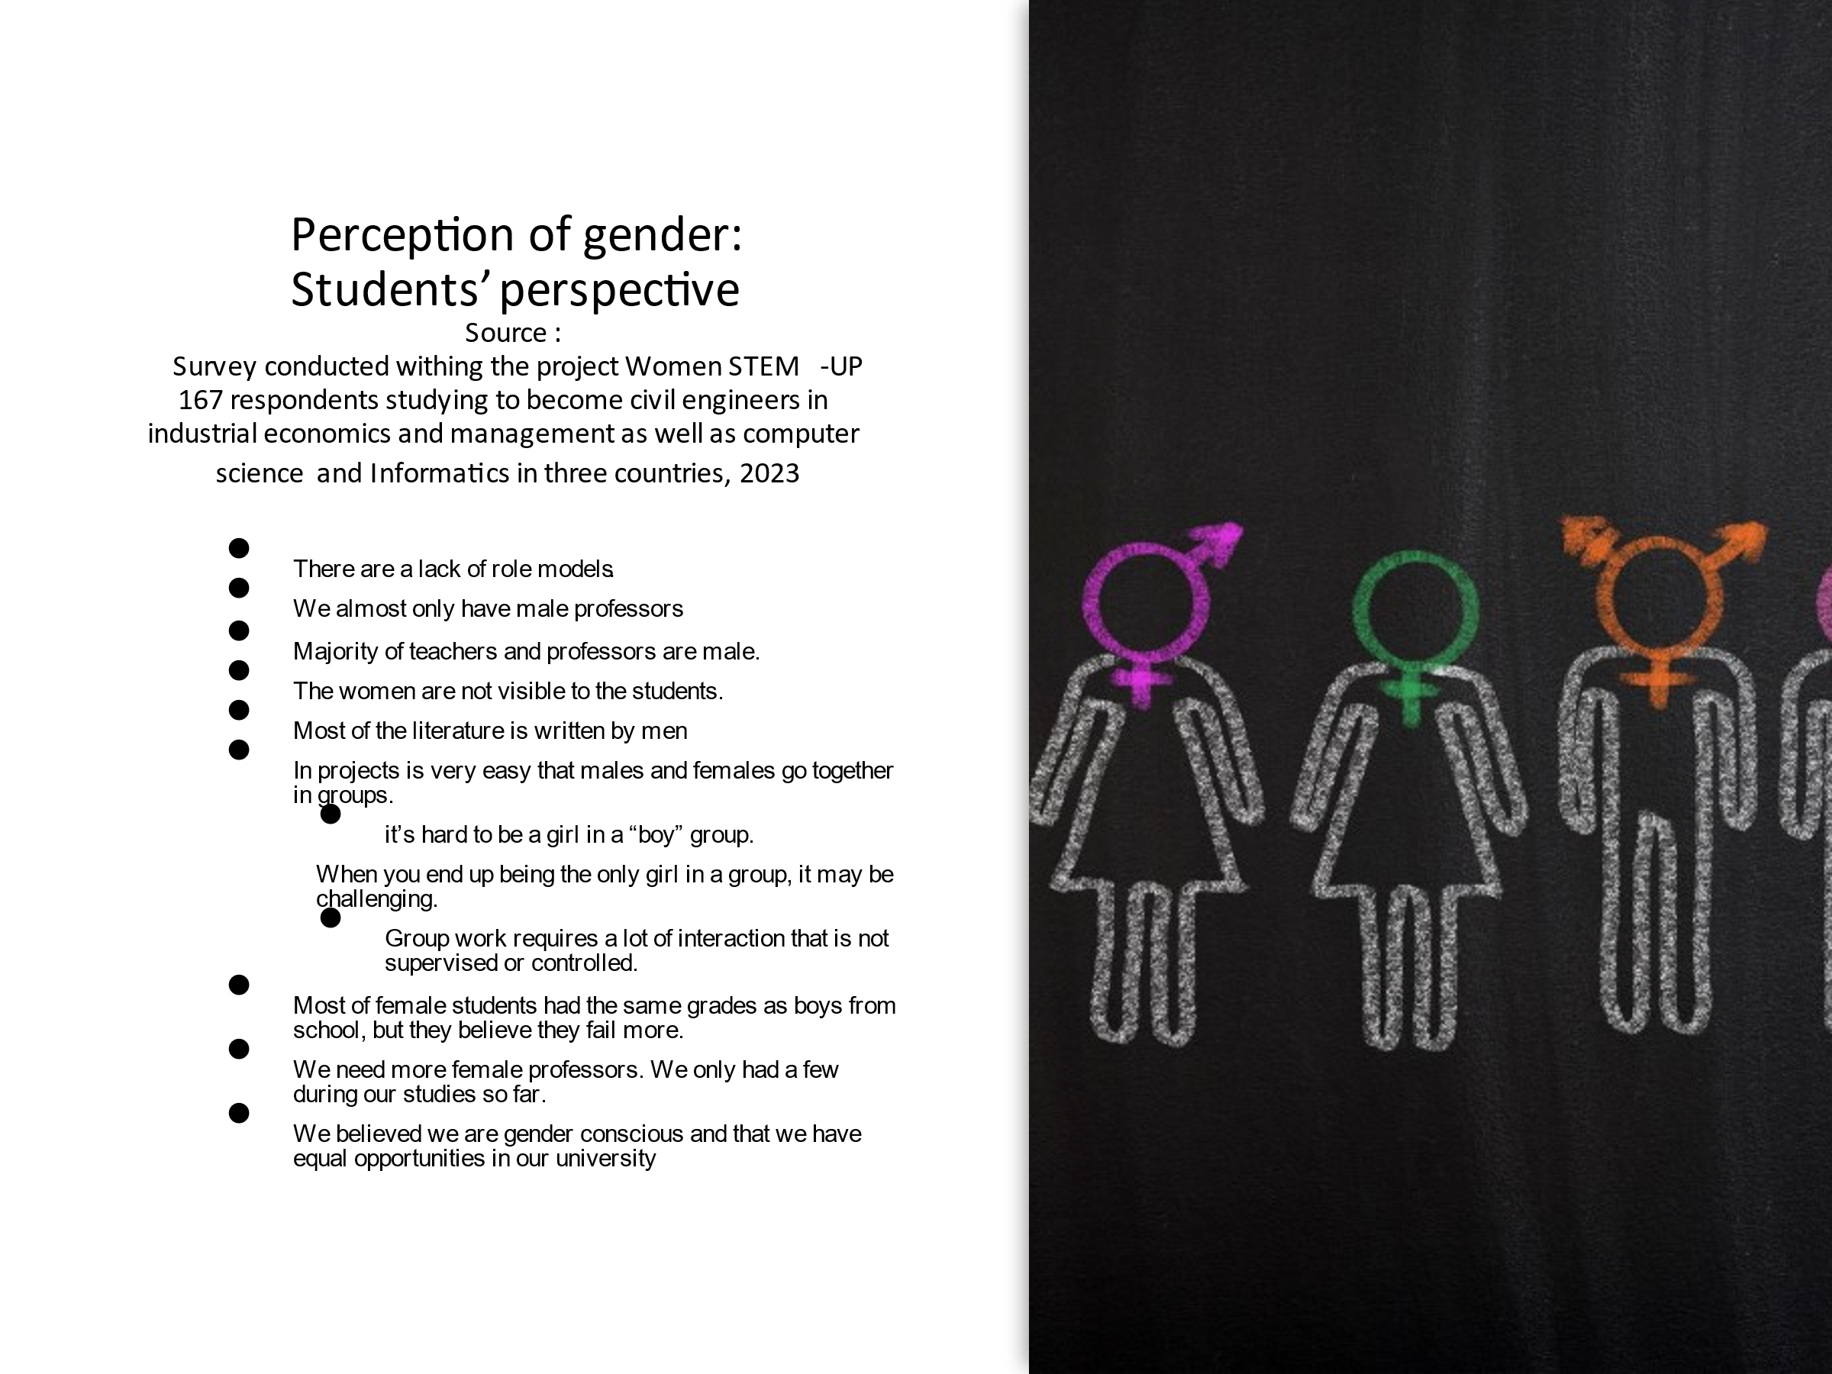
3.6 Students' perceptions of gender

Slide 26
3.7 To avoid master suppression techniques
This part is about the need to avoid diminishing master suppression techniques in the interaction between teachers and students, students and students and students and teachers
Teachers need to develop empathy towards attitudes that break gender-based stereotypes in class activities for example group work. Master suppression techniques has shown to have big impact in quality and effectiveness of teaching and learning and are defined as strategies of social manipulation by which a dominant group maintains such a position in an (established or unexposed) hierarchy.
Below you find some examples of 5 behavior to be counteracted related to master suppression techniques important to consider to improve interaction in classroom, projects and group tasks.

Slide 27
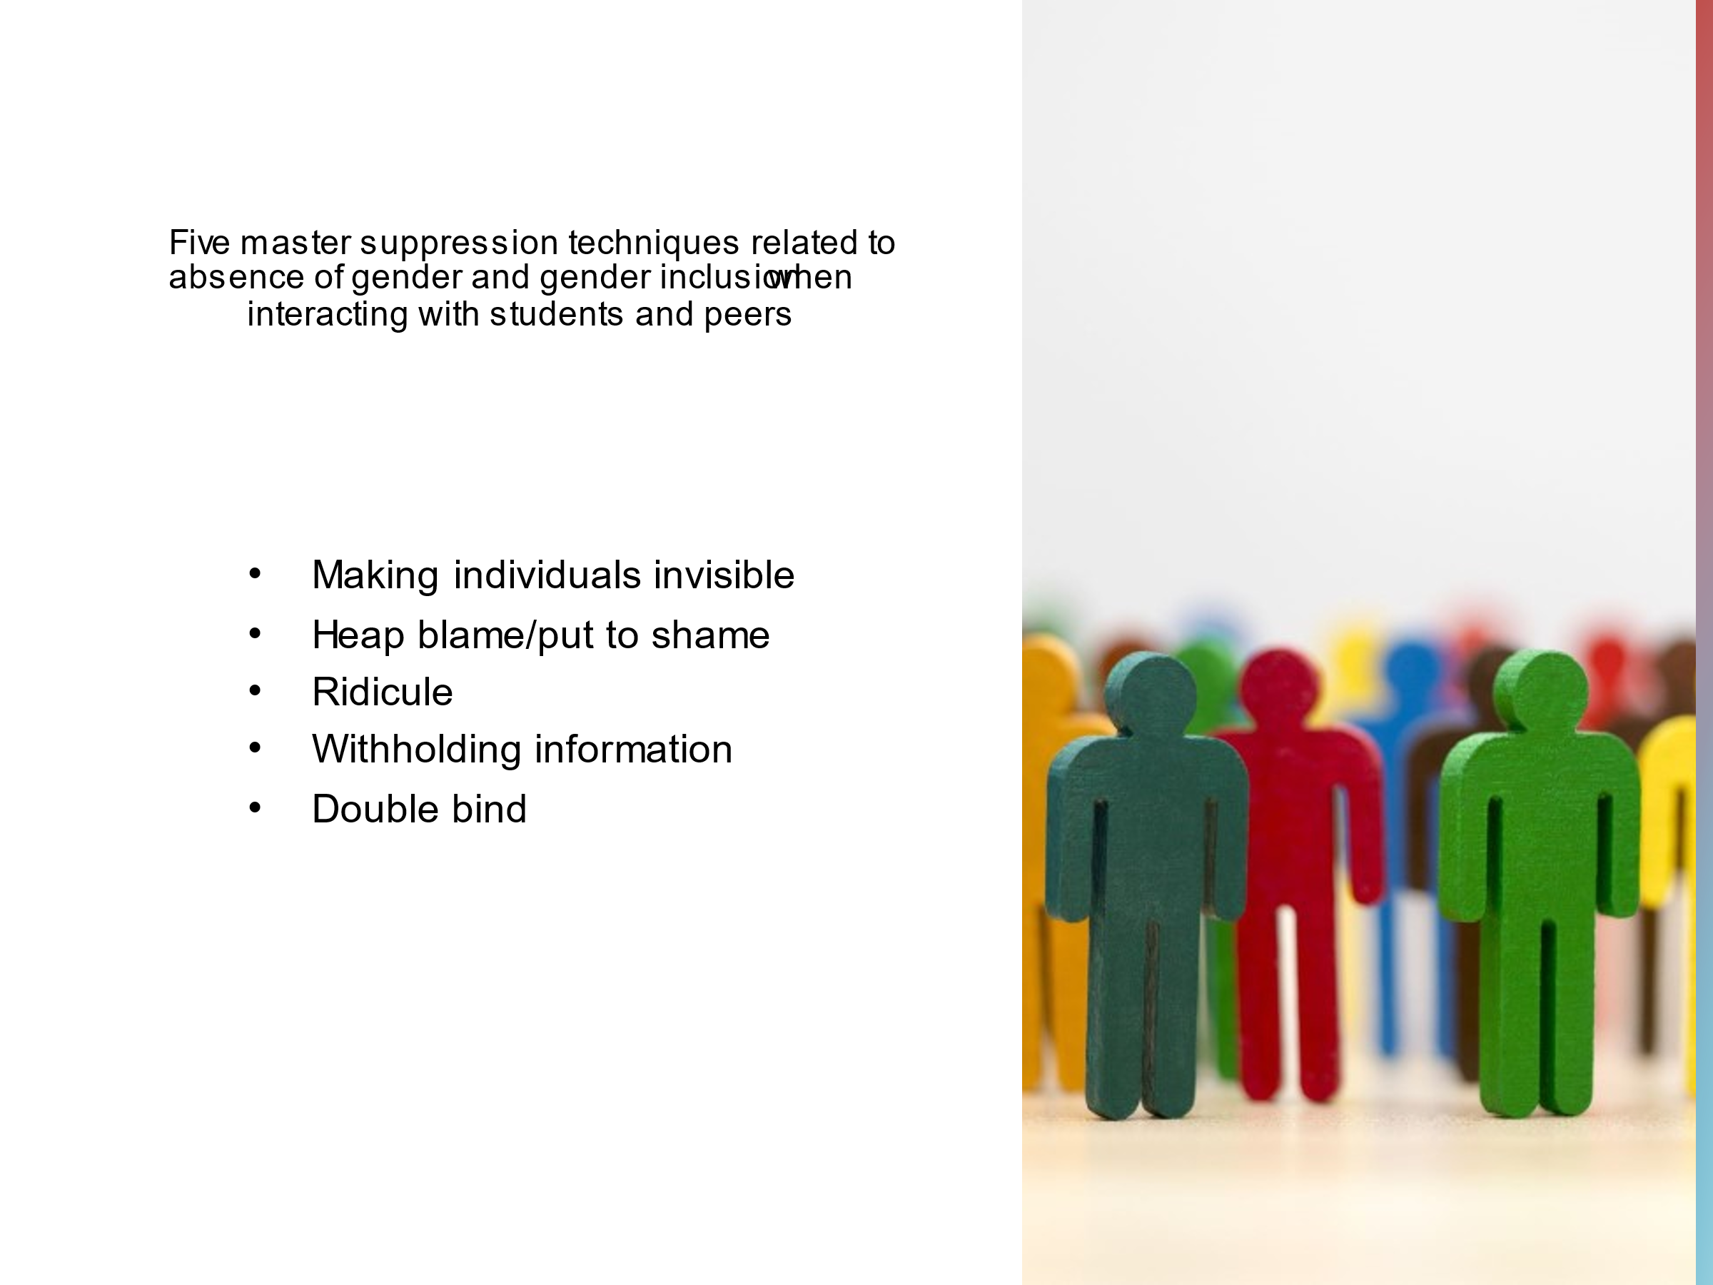
Master suppression techniques

Slide 28
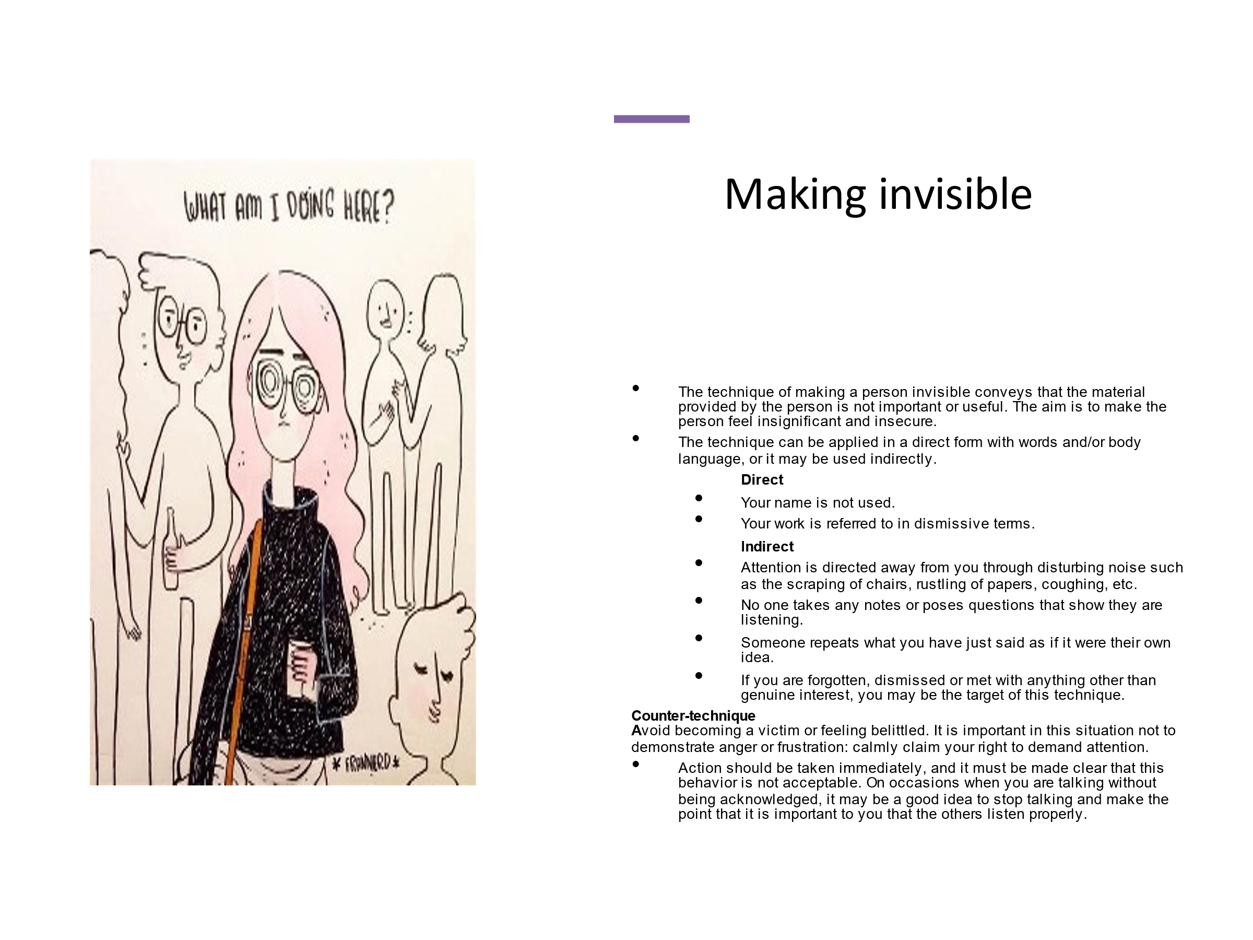
Making invisible

Slide 29

Heap blame/put to shame

Slide 30
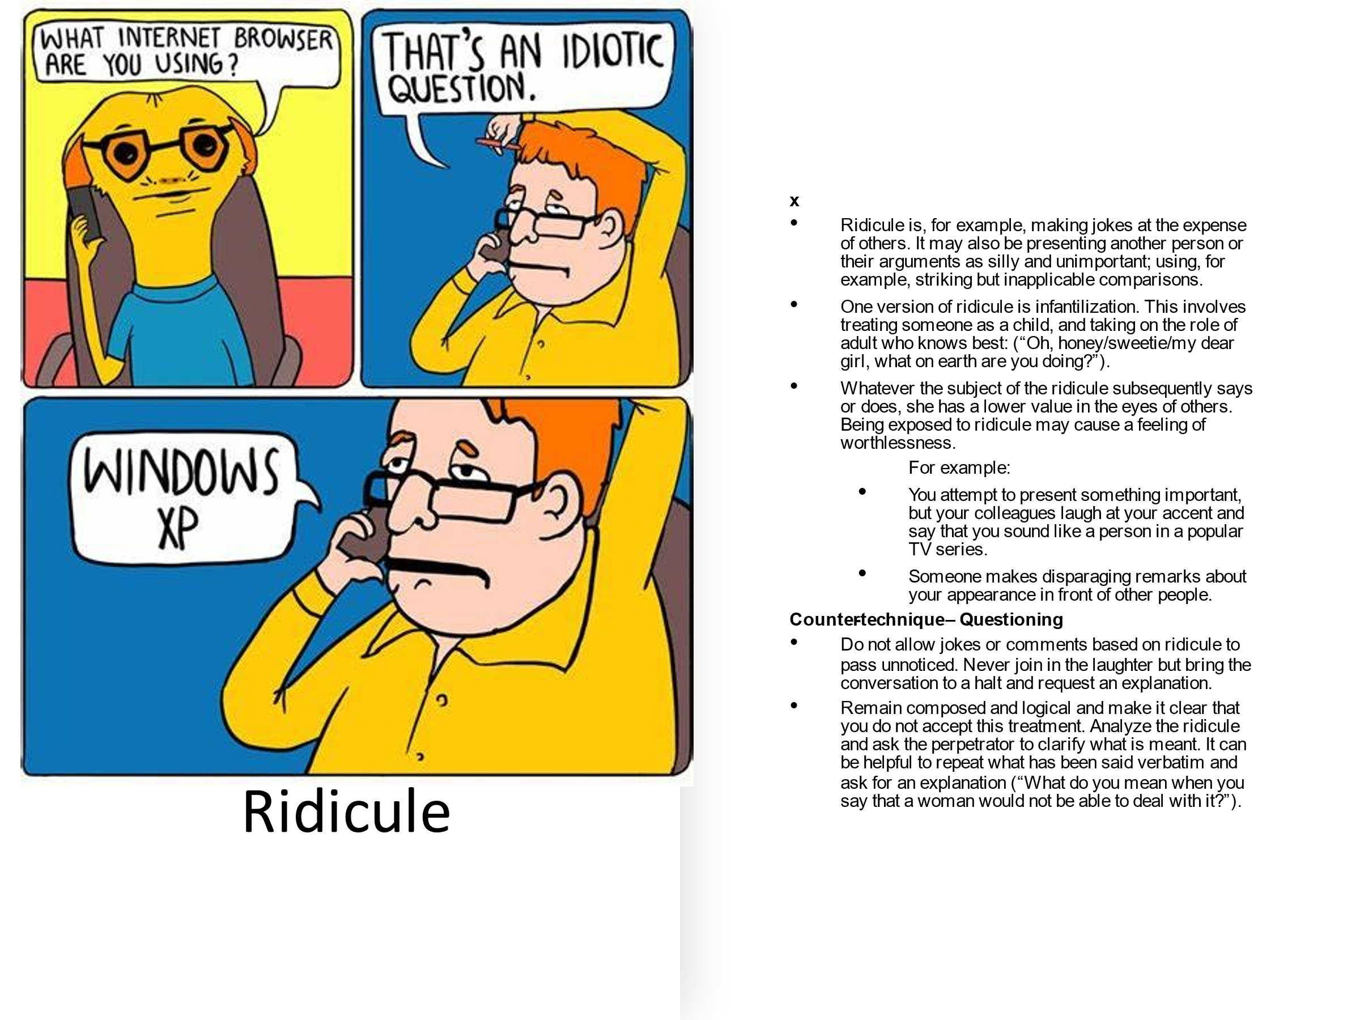
Ridicule

Slide 31
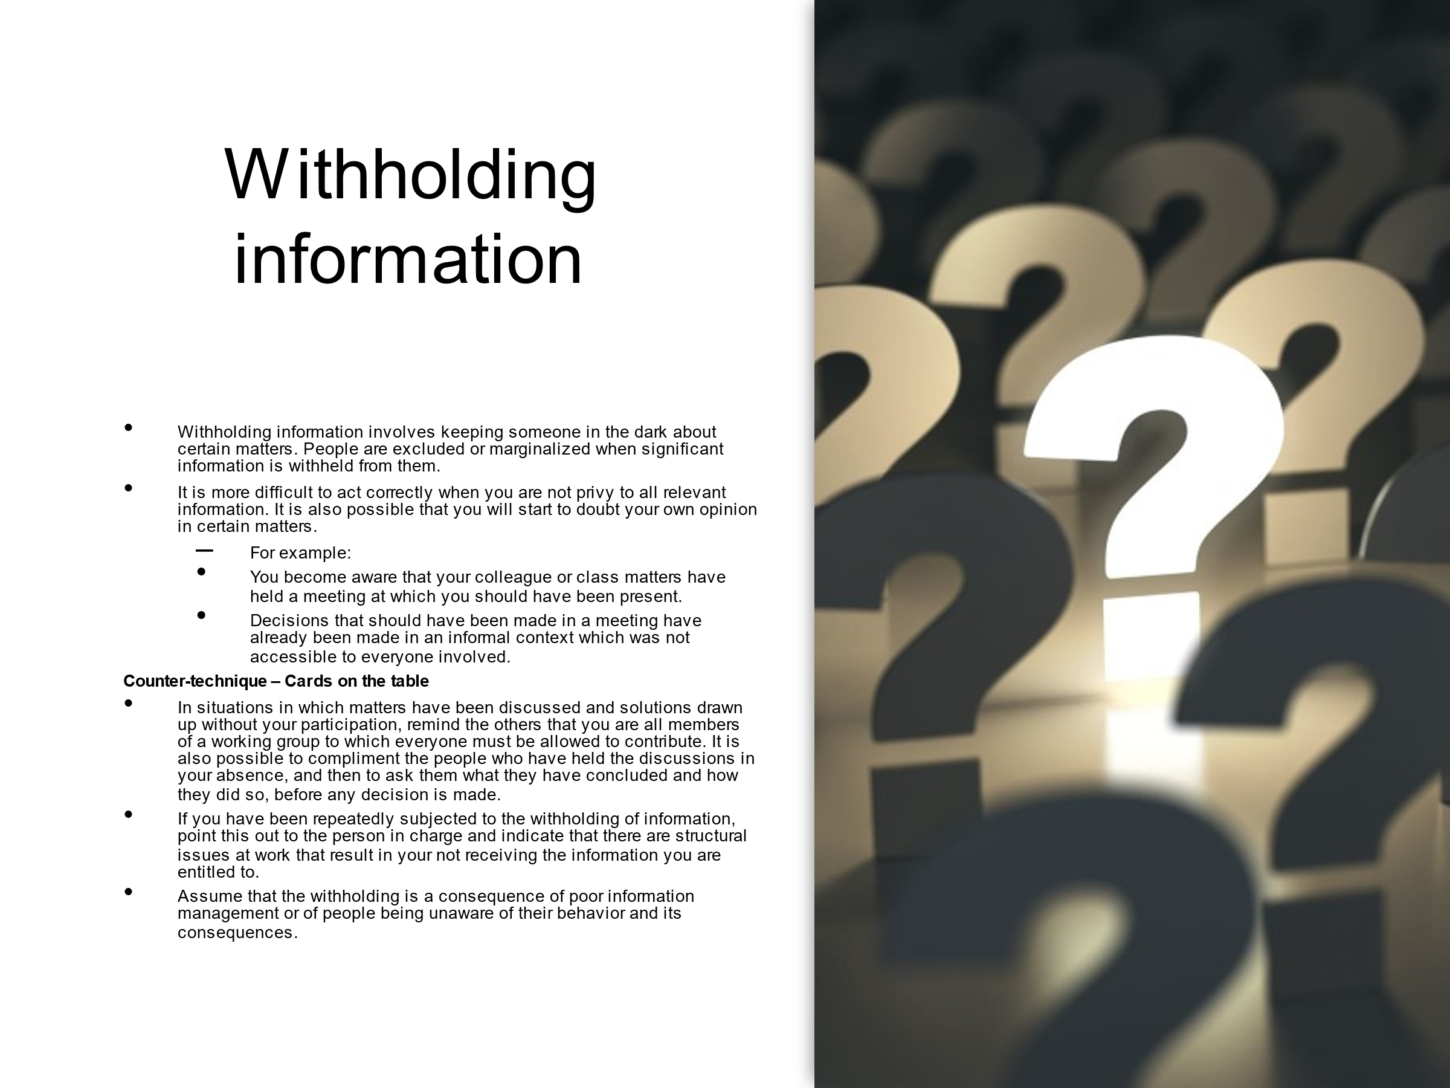
Withholding information

Slide 32

Double bind

Slide 33
3.8 Reflection of gender balance teaching methods into practice
This part of the online course ends with some questions that can be discussed with a group of colleagues.
A suggested approach is
Select a number of questions (about 5) from the questions below
Then, first think for yourself and write down some supporting words (5-10 min)
Then talk in pairs about your thoughts and reflections where both get to speak equally (10-15 min)
Finally, you can discuss in the larger group (15-20 min)

Slide 34
Questions to discuss with colleagues (1/3)
What obstacles prevent women from advancing in STEM academic careers?
How can universities ensure that women and men have equal access to resources and opportunities?
How can universities promote a culture of equality and inclusion?
How can universities support students who experience discrimination or harassment based on gender?
How can universities foster an environment where all students feel welcome and included?
Do you consider that gender is significant in learning, knowledge and teaching? Why, why not?
Why is it important to work with more gender-inclusive teaching at the university?

Slide 35
Questions to discuss with colleagues (2/3)
What role do you think universities have in advancing gender equality?
What gender and gender aspects are there in your teaching subject?
What knowledge and attitudes do the students need during their education?
What knowledge and attitudes do the students need when they enter the working world?
How do you work to integrate gender-balanced teaching?
What norms and values characterize the activities at our university/department/course:
— in conversations about the students?
— in the choice of literature?
— in how students are divided into groups?
What climate do you offer the students in the classroom?
How do you distribute the word and the speaking space in the classroom?
the teaching situation.
How do you make changes in your teaching method when you notice that a pattern is emerging where speaking time between people of different genders is unevenly distributed?

Slide 36
Questions to discuss with colleagues (3/3)
How do you make yourself aware of how you pick up what the students say and what significance women's and men's contributions have in the teaching? Who get follow-up questions or are referred to later during the lesson, for example
The intersectional perspective, e.g. gender and ethnicity when it comes to all students having equal opportunities in teaching?
How can you identify master suppression techniques in your classroom?

